Slide 1
KNN Classification

Slide 2
Overview
What is KNN ?
Why we need KNN ?
How do we choose the factor K ?
When we use KNN ?
How KNN Works with Use Case?
Improving KNN
Disadvantages of KNN
Conclusion
References

Slide 3
What is KNN ?
KNN is one of the simplest Supervised ML Algorithm.
KNN is the supervised machine learning algorithm used for classification and regression.
It classifies a data point based on how its neighbours are classified.
KNN stores all available cases and classifies new cases based on a similarity measure.

Slide 4
It manipulates the training data and classifies the new test data based on distance metrics.
One of the most basic forms of instance learning
KNN is a non-parametric algorithm, which means it does not make any assumptions about the underlying data distribution.
It finds the k-nearest neighbors to the test data, and then classification is performed by the majority of class labels.

Slide 5
Why we need KNN ?
Using K-Nearest Neighbor, we predict the category of the test point from the available class labels by finding the distance between the test point and trained k nearest feature values.
Because KNN is based on feature similarity.
We can do classification using KNN Classifier.

Slide 6
How do we choose the factor K ?
As we know KNN Algorithm is based on feature similarity by choosing the value K is process called Parameter Tuning.
It is important for better accuracy.
There are no pre-defined statistical methods to find the most favorable value of K.
Odd value of k is selected to avoid confusion between two classes of data.

Slide 7
Initialize a random K value and start computing.
We select the K entries in our database which are closet to the new sample.
Choosing a small value of K leads to unstable decision boundaries.
The substantial K value is better for classification as it leads to smoothening the decision boundaries.
Derive a plot between error rate and K denoting values in a defined range. Then choose the K value as having a minimum error rate.

Slide 8
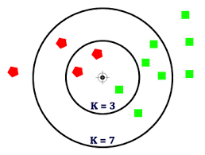
Choosing the factor K ?

Slide 9
When we use KNN ?
When data is Labelled(feature names)
KNN is used for both “binary” and “multi-class classification”
Dataset is small

Slide 10
Lazy learning (e.g., instance-based learning): Simply stores training data (or some minor processing) and waits until it is given a test tuple.
Less time in training but more time in predicting.

Slide 11
How KNN Works ?
Input KNN Process Predicted Class
Use Case:- On BMI(Body Mass Index)
Consider a dataset having two variables Height(cm) & Weight(kg)
Each Point is classified as Normal(N) or Underweight(UW)

Slide 12
Given Data:
Weight | Height | Class
51 | 167 | UW
62 | 162 | N
69 | 176 | N
64 | 173 | N
56 | 174 | UW
58 | 169 | N
55 | 170 | N
57 | 173 | N

Slide 13
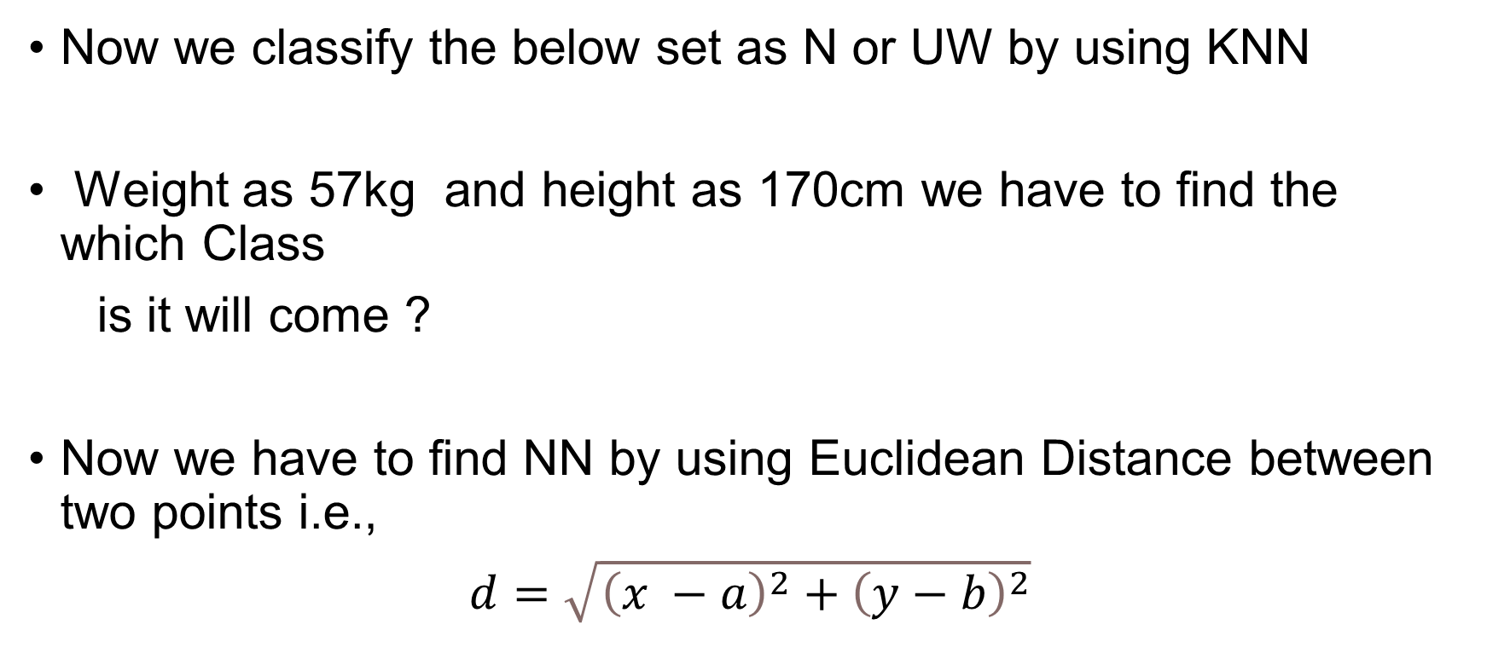
On the basis of the given data:
Now we classify the below set as N or UW by using KNN
Weight as 57kg and height as 170cm we have to find the which Class
is it will come ?
Now we have to find NN by using Euclidean Distance between two points i.e.,
$d=\sqrt{{\left(x −a\right)}^{2}+{\left(y−b\right)}^{2}}$

Slide 14
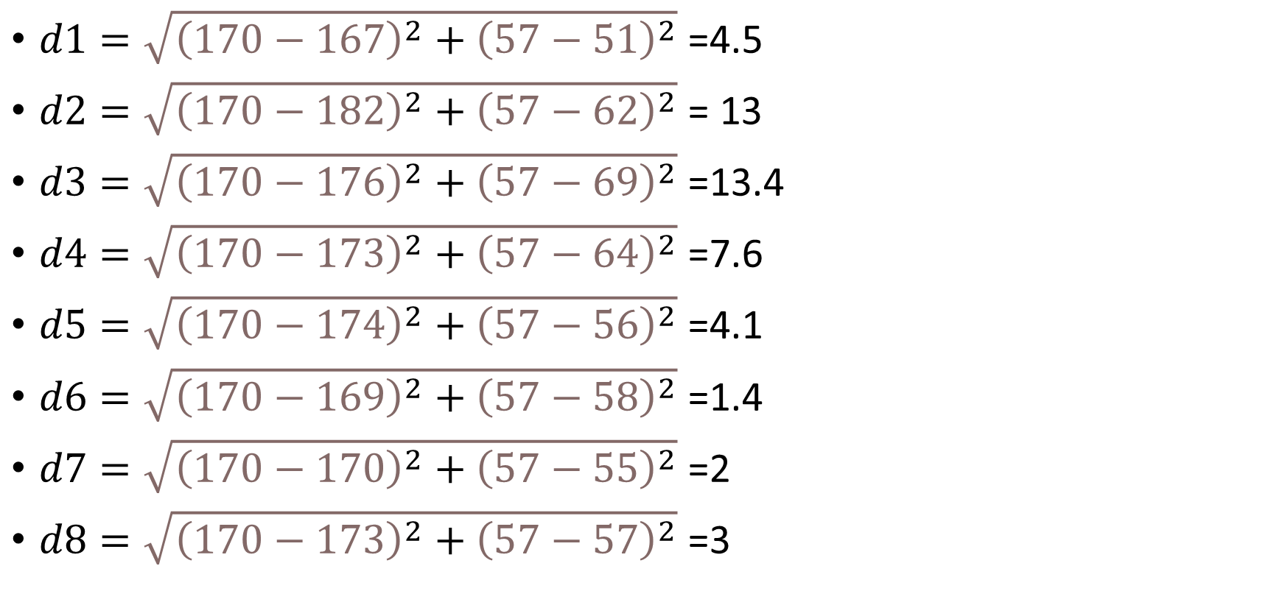
Calculating Distance:
$d1=\sqrt{{\left(170−167\right)}^{2}+{\left(57−51\right)}^{2}}$ =4.5
$d2=\sqrt{{\left(170−182\right)}^{2}+{\left(57−62\right)}^{2}}$ = 13
$d3=\sqrt{{\left(170−176\right)}^{2}+{\left(57−69\right)}^{2}}$ =13.4
$d4=\sqrt{{\left(170−173\right)}^{2}+{\left(57−64\right)}^{2}}$ =7.6
$d5=\sqrt{{\left(170−174\right)}^{2}+{\left(57−56\right)}^{2}}$ =4.1
$d6=\sqrt{{\left(170−169\right)}^{2}+{\left(57−58\right)}^{2}}$ =1.4
$d7=\sqrt{{\left(170−170\right)}^{2}+{\left(57−55\right)}^{2}}$ =2
$d8=\sqrt{{\left(170−173\right)}^{2}+{\left(57−57\right)}^{2}}$ =3

Slide 15
Given Data:
Weight | Height | Class
Eucliden Distance
51 | 167 | UW
62 | 162 | N
69 | 176 | N
64 | 173 | N
56 | 174 | UW
58 | 169 | N
55 | 170 | N
57 | 173 | N
6.7
13
13.4
7.6
4.1
1.4
3
2

Slide 16
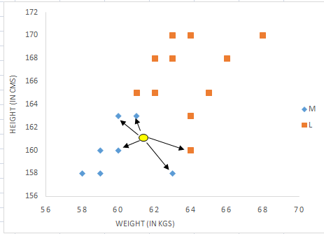
Graphical Representation:

Slide 17
From the data table the nearest neighbours are 58kg & 169cm, 55kg & 170cm, 57kg & 173cm in this all cases are Normal.
Here K=3 , Majority of Neighbours are pointing Normal.
So the point at 57kg & 170cm is at Normal.

Slide 18
Does KNN Requires Standardization ?
Yes, Here we use Euclidean Distance so that we definitely have to apply standardization.
So that computational distance will be easy.

Slide 19
Improving KNN
Weighting examples from the neighborhood.
Measuring “closeness”
Finding “close” examples in a large training set quickly.

Slide 20
Disadvantages of KNN
Doesn't work well with a large dataset.
Performance will decreases when features increases because the distance between points become less informative in higher dimensions.
Choosing the right K Value is difficult.
KNN is impacted by the outliers.

Slide 21
Conclusion
Overall, KNN is a simple yet effective algorithm that can be used as a baseline for many machine learning tasks.
However, it is important to consider its limitations and use it appropriately in the context of the problem at hand.

Slide 22
References
https://a.impartus.com/ilc/#/video/id/5354365
https://a.impartus.com/ilc/#/video/id/5354365
https://www.youtube.com/watch?v=otolSnbanQk
https://www.youtube.com/watch?v=otolSnbanQk

Slide 23
Thankyou

